Slide 1
RAFT: Recurrent All-Pairs Field Transforms for Optical Flow
CVPR 2020
AUTHOR：Zachary Teed, Jia Deng
REPORTER : 鄧仲恩
NTUST GAMELab cs.CV

Slide 2
Outline
Introduction
Related Work
Approach
Experiments
Conclusion
NTUST GAMELab cs.CV

Slide 3
Introduction
3
NTUST GAMELab cs.CV

Slide 4
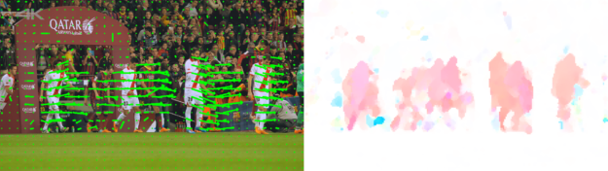
Introduction - Optical flow
Optical flow
Tradition (Full flow) a) not robust b) difficulties in hand-designing
Deep Learning(Flownet 2.0、Deepv2d、Liteflownet) a) directly predict flow b) faster c) better performance
NTUST GAMELab cs.CV

Slide 5
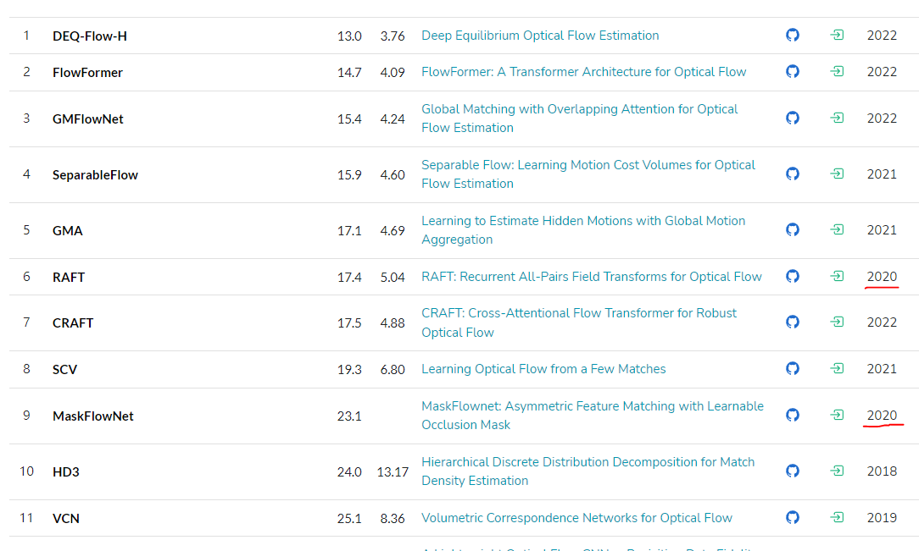
Introduction - Recurrent All-Pairs Field Transforms
State-of-the-art accuracy a) F1-all error 6.1% -> 5.1% b) end-point-error 4.098 pixels -> 2.855 pixels
Strong generalization 5.04 pixel end-point-error with only synthetic data.
High efficiency 10 frames per second.
NTUST GAMELab cs.CV
Notes:
2. KITTI

Slide 6
Related Work
6
NTUST GAMELab cs.CV

Slide 7
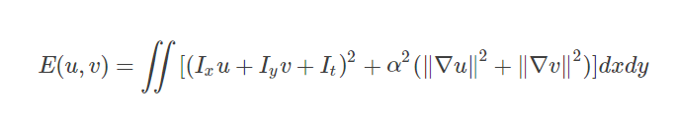
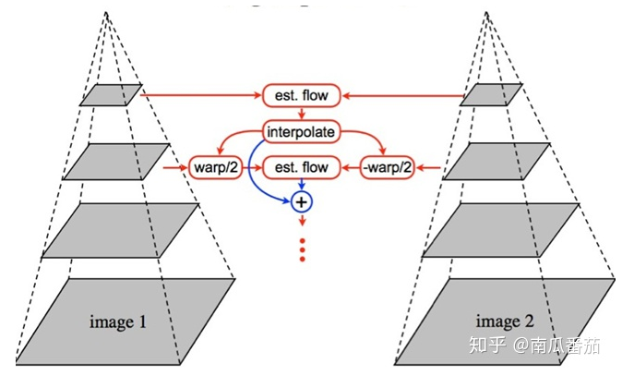
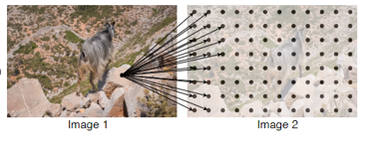
Related Work - Optical Flow as Energy Minimization
Horn and Schnuck use performing gradient steps.
TV-L1 use L1 data term and total variation regularization
Coarse-to-Fine
4D cost volume
NTUST GAMELab cs.CV
Notes:
霍恩-舒克提出用梯度來辨識光流
布萊克和阿南丹L1 正則項與去躁

Slide 8
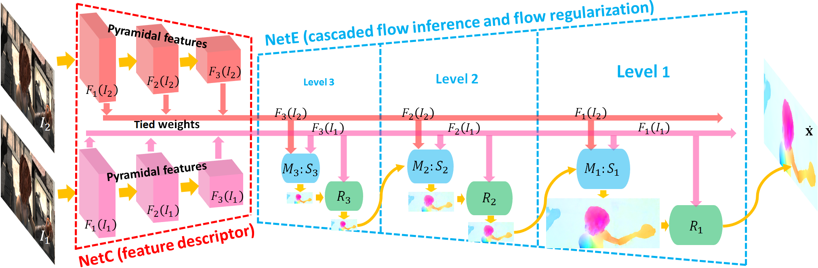
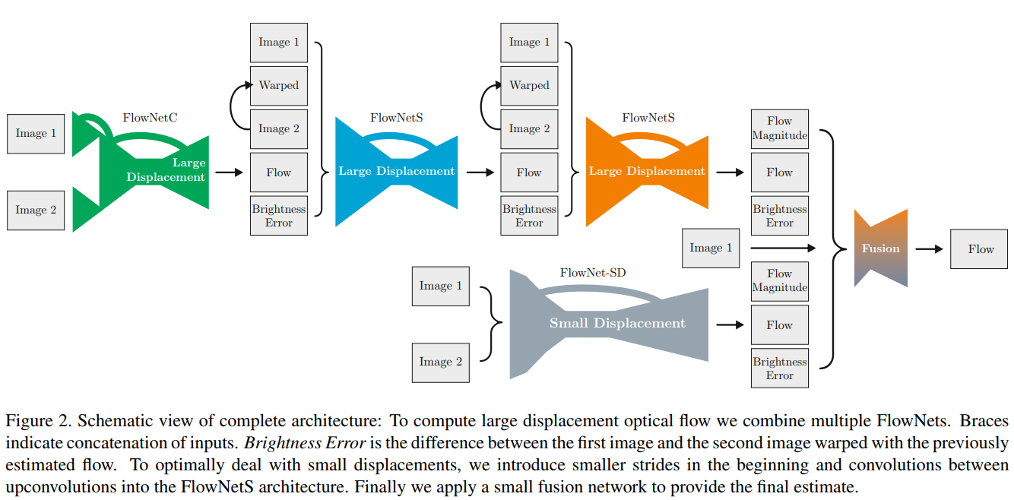
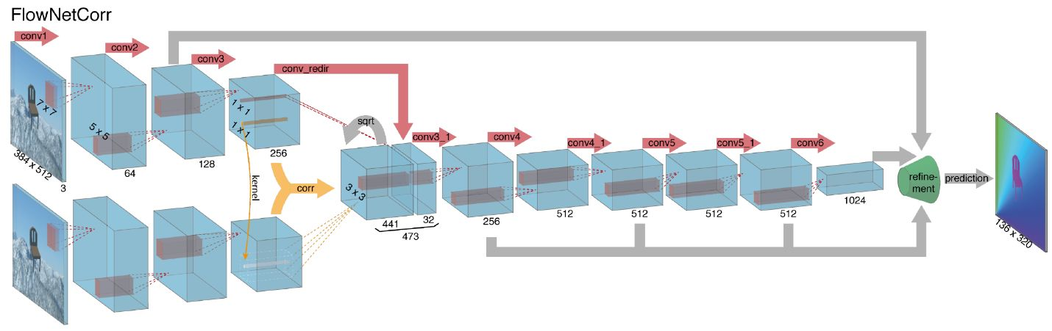
Related Work - Direct Flow Prediction
PWC-Net
LiteFlowNet
ScopeFlow
FlowNet
NTUST GAMELab cs.CV
Notes:
直接預測

Slide 9
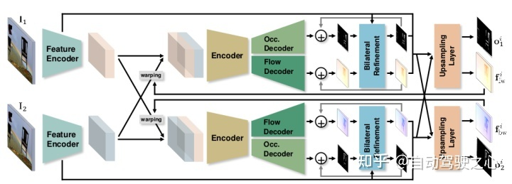
Related Work - Iterative Refinement for Optical Flow
FlowNet2.0
SpyNet , PWC-Net , LiteFlowNet, and VCN (coarse-to-fine pyramids)
IRR(shares weights)
TrellisNet and DEQ(LSTM)
NTUST GAMELab cs.CV
Notes:
1.堆疊模型 跌代有效
2.金字塔結構 跌代
4.CNN+RNN

Slide 10
Approach
10
NTUST GAMELab cs.CV

Slide 11
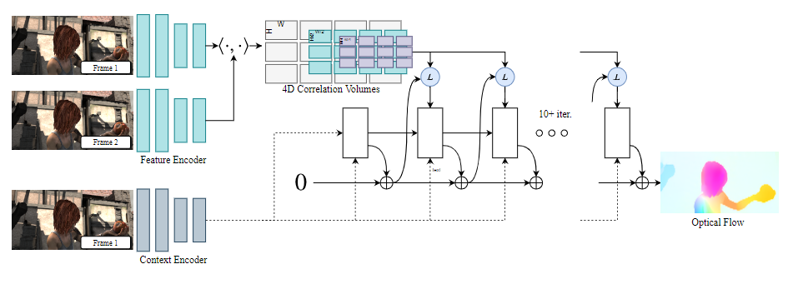
Approach
Feature Extraction
Computing Visual Similarity
Iterative Updates
Supervision
NTUST GAMELab cs.CV

Slide 12
Approach - Feature Extraction
Image(H, W, 3) -> 1 / 8 features (H / 8, W / 8, 256)
6 residual block
NTUST GAMELab cs.CV
Notes:
3. Share width
4. Same with feature encoder

Slide 13
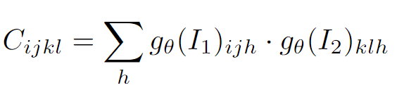
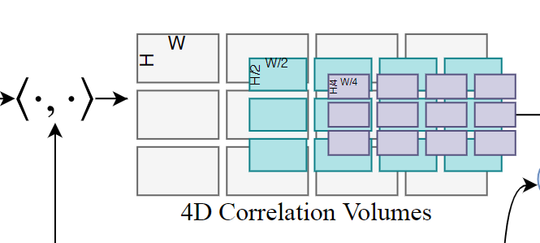
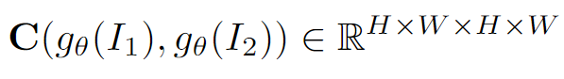
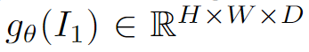
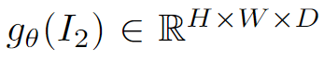
Approach - Computing Visual Similarity
.
NTUST GAMELab cs.CV
Notes:
計算視覺相似度
4D相關體積

Slide 14
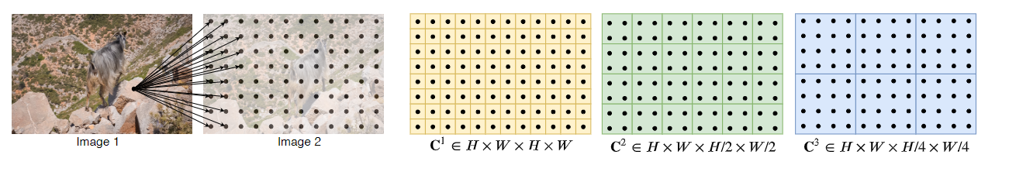
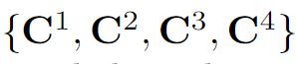
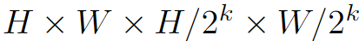
Approach - Computing Visual Similarity(Pyramid)
NTUST GAMELab cs.CV
Notes:
金字塔結構
large and small 位移
I1 high resolution information
快速移動小物件

Slide 15
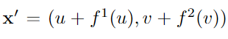
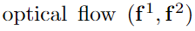
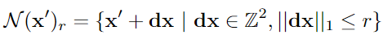
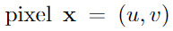
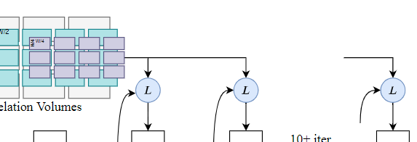
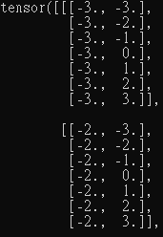
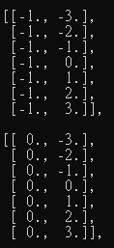
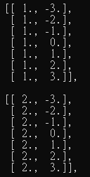
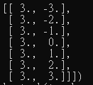
Approach - Computing Visual Similarity(Lookup)
1
2
3
bilinear sampling->(batch_size, (R*2+1)^2*K, h, w)
NTUST GAMELab cs.CV

Slide 16
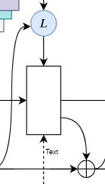
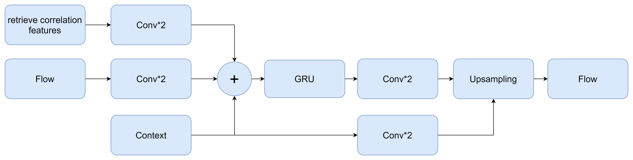
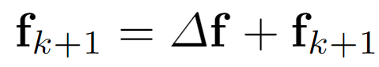
Approach - Iterative Updates
NTUST GAMELab cs.CV

Slide 17
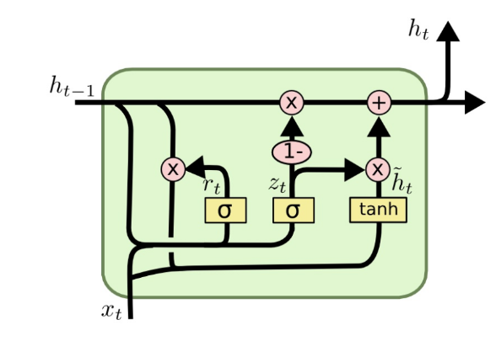
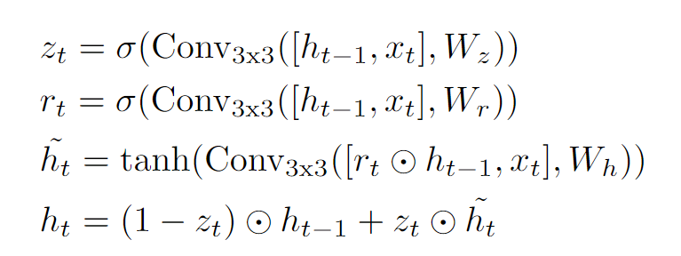
Approach - Iterative Updates(GRU)
Conv1*5+Conv5*1
NTUST GAMELab cs.CV

Slide 18
Approach - Iterative Updates(Upsampling)
X
=
NTUST GAMELab cs.CV

Slide 19
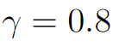
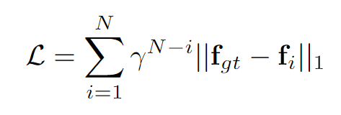
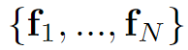
Approach - Supervision
NTUST GAMELab cs.CV

Slide 20
Experiments
20
NTUST GAMELab cs.CV cs.CL

Slide 21
Experiments
Dataset
Test on Sintel and KITTI.
Pretrain on FlyingChairs and FlyingThings.
Test on 1080p video from the DAVIS.
Details
2080Ti GPUs.
AdamW
32 flow updates on Sintel and 24 on KITTI
FlyingThings,100k iter, 12 batch size
FlyingThings3D,100k iter, 6 batch size
……
NTUST GAMELab cs.CV

Slide 22
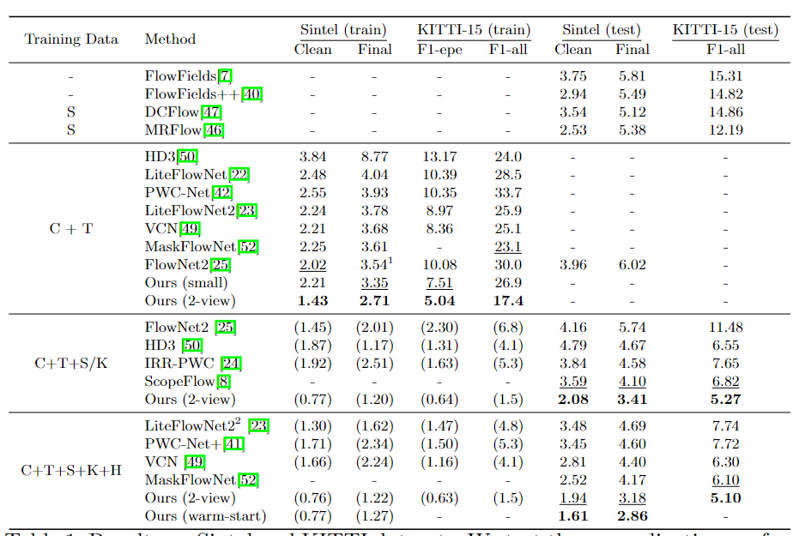
Experiments - Sintel and KITTI
end-point-error
NTUST GAMELab cs.CV
Notes:
FlyingChairs(C)
FlyingThings(T),
KITTI(K)
HD1K(H)
Sintel(S)
Ft ->finetuned on Sintel data
C+T 最好
EPE (end-point-error) of 1.43 Sintel 表示最好泛用性在不同數據集中 <- 好的架構
warp-start -> previous frame
C+T+S+K+H better 0.9 pixels (36%) 1.2 pixels (30%)
8.36 to 5.04(40%)

Slide 23
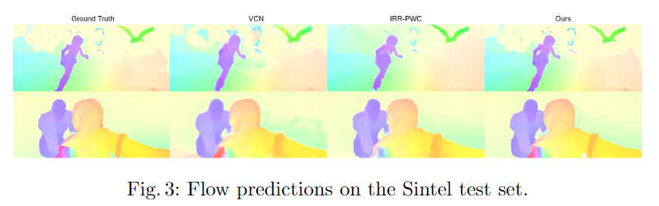
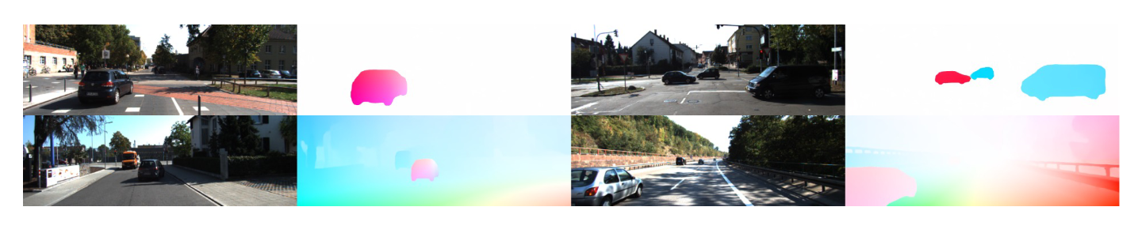
Experiments – Sintel and KITTI
NTUST GAMELab cs.CV
Notes:
2.KITTI

Slide 24
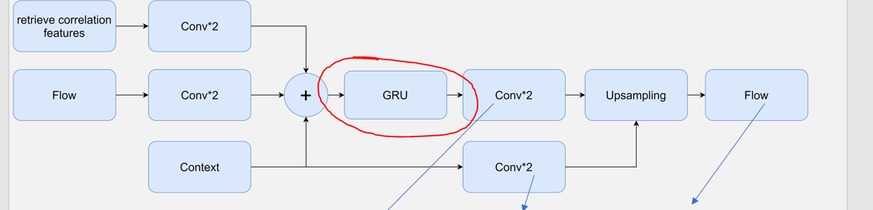
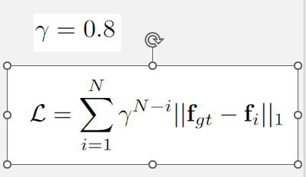
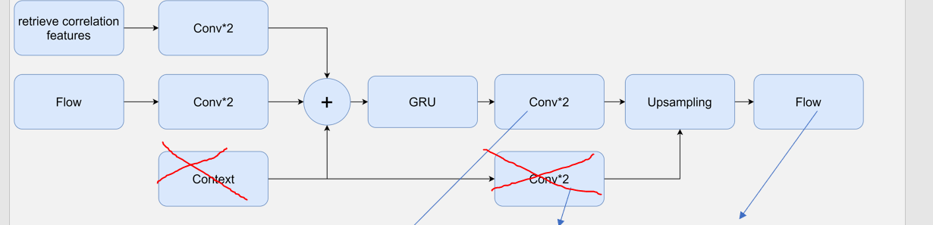
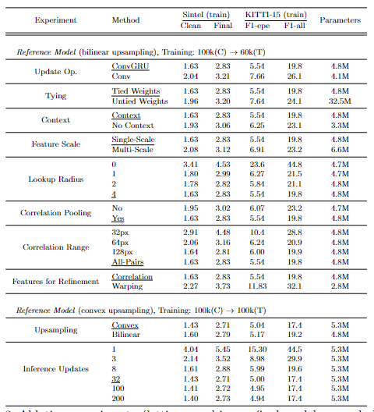
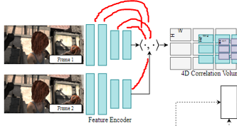
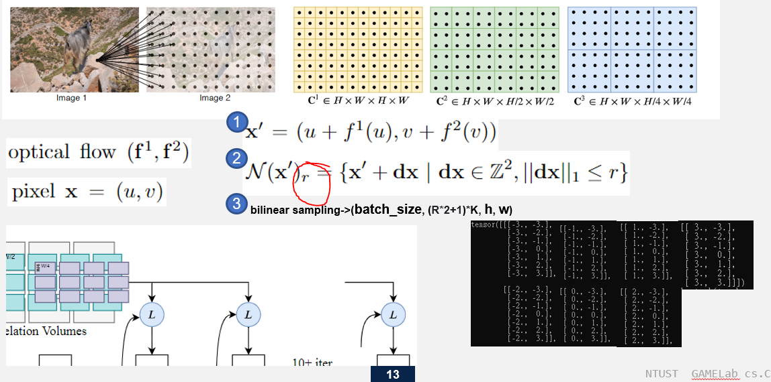
Experiments - Ablations
1
Conv*3+Relu
2
3
4
5
NTUST GAMELab cs.CV

Slide 25
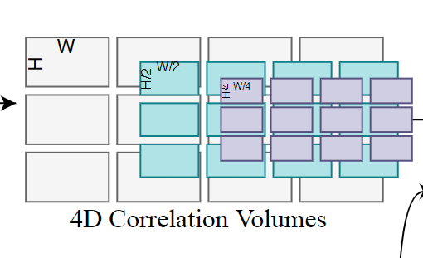
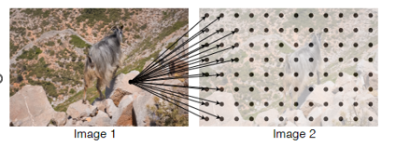
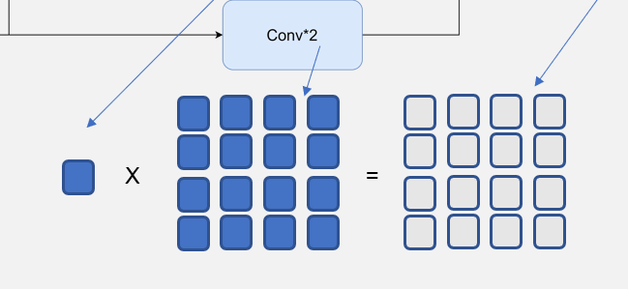
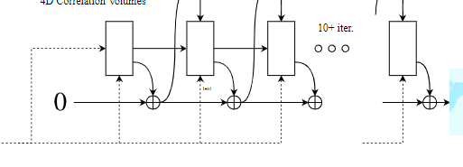
Experiments - Ablations
1、3
2
4
5
NTUST GAMELab cs.CV

Slide 26
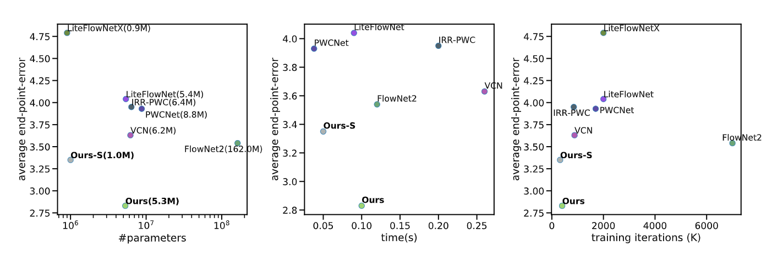
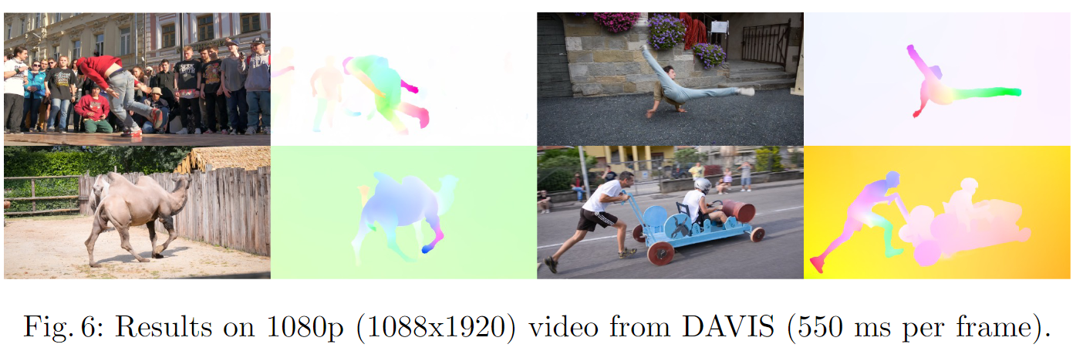
Experiments - Timing and Parameter Counts
NTUST GAMELab cs.CV

Slide 27
Conclusion
27
NTUST GAMELab cs.CV cs.CL

Slide 28
Conclusion
Proposed RAFT a new end-to-end trainable model for optical flow.
Achieves state-of-the-art accuracy across a diverse range of datasets.
NTUST GAMELab cs.CV cs.CL

Slide 29
報告完畢 THE END
謝謝 Thank You
NTUST GAMELab cs.CV cs.CL

Slide 30
自評表
FAQ | 完成
1. Paper的Input / Process / Output是什麼? | ☑
2. Paper主要動機、目的、應用為何?如何應用到我們的研究?是否能應用到遊戲製作技巧上? | ☑
3. Paper的貢獻?最重要的貢獻?價值?厲害在哪裡?強在哪裡?好在哪裡?優點?方法?想法?為什麼要這樣用?有什麼特別的?困難的地方在哪?為什麼難?跟Previous Work之間的差異是什麼? | ☑
4. Paper的Framework? | ☑
5. Paper中專有名詞的定義和意義和有哪些和正確發音? | ☑
6. Paper中公式所代表的意義?物理意義?參數?為什麼要這樣定義的目的和原因? | ☑
7. Paper的缺點?限制?哪邊可以改進?我們有沒有辦法發表一個方法解決? | x
8. Results的圖/表意義和如何閱讀?足夠嗎?數據為什能夠比其他的Paper好?是否有作弊?特別美化?為什麼實驗要這樣設計?結果的意義? 作者要讓我們知道什麼?如何驗證結果?如何從Results驗證Paper提到的優點、好處、貢獻? | ☑
9. Paper是上什麼期刊?出處?Title的意思是什麼?被何人發表? | ☑
10. 讀完Paper之後你有沒有辦法實現?用程式寫出來? | ☑

Slide 31
What You’ve Learned
Critical technique:
Optical flow
RAFT
Good math expression:
Recommended references:
All mentioned methods in this PPT.
Good experiment approach:
Other:

Slide 32


